Slide 1
Computer Systems An Integrated Approach to Architecture and Operating Systems
Chapter 12
Multithreaded Programming and Multiprocessors
©Copyright 2008 Umakishore Ramachandran and William D. Leahy Jr.

Slide 2
12 Multithreaded Programming and Multiprocessors
Is human activity sequential or parallel?
How do we write programs?

Slide 3
What is a thread?

Slide 5
12.1 Why Multithreading?
Better, more abstract, more modular way of solving a problem
Separate computation from I/O
compute
thread
I/O
thread
compute
I/O request
I/O
I/O complete
I/O result
needed
I/O result
needed
compute
(a) Sequential process
(b) Multithreaded process

Slide 6
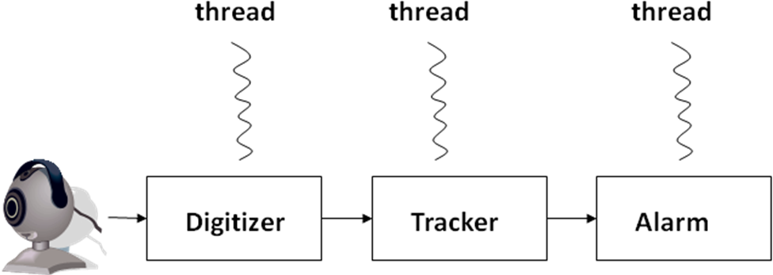
12.1 Why Multithreading?
Better, more abstract, more modular way of solving a problem
Separate computation from I/O
Take advantage of multiprocessors

Slide 7
12.2 Programming support for threads
Threads as a programming abstraction.
Want to
dynamically create threads
communicate among threads
synchronize activities of threads
terminate threads
Will implement a library to provide functionality desired

Slide 8
12.2.1 Thread creation and termination
A thread executes some portion of a program
Just like a program it has an entry point or a point where it begins execution
When a thread is created this entry point is defined usually as the address of some function

Slide 9
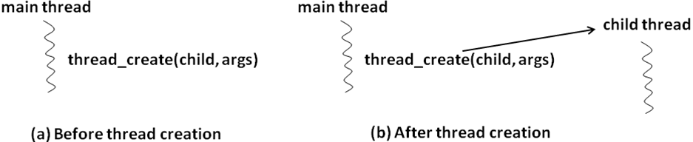
12.2.1 Thread creation and termination
tid_t thread_create (top-level procedure, args);

Slide 10
Processes are Protected
Process
Process
Process
Process
Process

Slide 11
Multiple Threads Can Exist in a Single Process Space
Process
Thread
Process
Thread
Thread
Thread
Thread
Thread
Thread
Thread
Process
Process
Thread
Thread
Thread
Process
Thread

Slide 12
12.2.1 Thread creation and termination
Thread automatically terminates when it exits the top-level procedure that it started in. Additionally, library may provide an explicit call for terminating a thread in same process:
thread_terminate (tid);
Where, tid is the system-supplied identifier of the thread we wish to terminate.

Slide 13
12.2.2 Communication among threads
Since threads share the same address space sharing memory is simple (well sort of…)
Appropriately qualified static variables can be visible to multiple threads

Slide 14
12.2.3 Data race and Non-determinism
Data Race is a condition in which multiple concurrent threads are simultaneously trying to access a shared variable with at least one threads trying to write to the shared variable.
int flag = 0; /* shared variable
initialized to zero */
Thread 1 Thread 2
while (flag == 0) { .
/* do nothing */ .
} .
if (flag == 0) flag = 1;
.
.

Slide 15
12.2.3 Data race and Non-determinism
Data Race is a condition in which multiple concurrent threads are simultaneously trying to access a shared variable with at least one threads trying to write to the shared variable.
int flag = 0; /* shared variable
initialized to zero */
Thread 1 Thread 2
while (flag == 0) { .
/* do nothing */ .
} .
if (flag == 0) flag = 1;
.
.

Slide 16
12.2.3 Data race and Non-determinism
int count = 0; /* shared variable initialized to zero */
Thread 1 (T1) Thread 2 (T2) Thread 3 (T3) Thread 4 (T4)
. . .
. . .
count++; count++; count++; printf(count)
. . . .
. . . .
What will print?

Slide 17
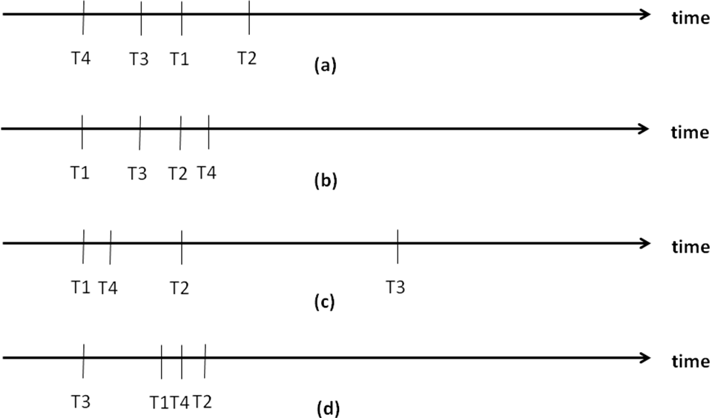
12.2.3 Data race and Non-determinism
Depends!

Slide 18
12.2.3 Data race and Non-determinism
Sequential Programming
Program Order (even with pipelining tricks)
Deterministic
Parallel Programming
Within a thread execution is program order
Order of execution of threads determined by a thread scheduler
Non-deterministic
Results may vary
High level language statements not atomic! More later

Slide 19
12.2.4 Synchronization among threads
Producer Thread
Consumer Thread
while(account number != 0);
Obtains an account number and a transaction amount
Places both in shared variables
while(account number == 0);
Takes the account number and transaction amount out of the shared variables
Processes the transaction and processes them
Sets account number to 0
Account
Amount

Slide 20
12.2.4 Synchronization among threads
Sections of code in different threads (or processes) which access the same shared variable(s) are called Critical Sections
We need to avoid any two critical sections from being active at the same time
Thus if one is in a critical section it must exclude the other and vice versa.
Thus this is called Mutual Exclusion
Variables used for this purpose are called mutex variables or just mutexes (singular: Mutex)

Slide 21
12.2.4 Synchronization among threads
Producer Thread
Consumer Thread
while(MUTEX == LOCKED);
MUTEX = LOCKED;
if(account == 0)
Obtains an account number and a transaction amount
Places both in shared variables
MUTEX = UNLOCKED;
while(MUTEX == LOCKED);
MUTEX = LOCKED;
if(account number != 0);
Takes the account number and transaction amount out of the shared variables
Processes the transaction and processes them
Sets account number to 0
MUTEX = UNLOCKED
Account
MUTEX
Amount

Slide 22
12.2.4 Synchronization among threads
In practice
mutex_lock_type mylock;
The following calls allow a thread to acquire and release a particular lock:
thread_mutex_lock (mylock);
thread_mutex_unlock(mylock);
Note: Only one thread at a time may lock the mutex!
There may also be calls to determine the state of a mutex

Slide 23
12.2.4 Synchronization among threads
T1
T2
T3
T4
Critical section
Critical section
Critical section
Critical section

Slide 24
12.2.4 Synchronization among threads
T1
T2
T3
T4
Critical section
Critical section
Critical section
Critical section
T1 is active and executing code inside its critical section.
T2 is active and executing code outside its critical section.
T3 is active and executing code outside its critical section.
T4 is blocked and waiting to get into its critical section. (It will get in once the lock is released by T1).

Slide 25
12.2.4 Synchronization among threads
int foo(int n) {
.....
return 0;
}
int main() {
int f;
thread_type child_tid;
.....
child_tid = thread_create (foo, &f);
.....
thread_join(child_tid);
}
Rendezvous

Slide 26
12.2.5 Internal representation of data types provided by the threads library
loop:
while(lock == RED)
{
// spin!
}
lock = RED;
// Access shared
lock = GREEN;
goto loop;
loop:
while(lock == RED)
{
// spin!
}
lock = RED;
// Access shared
lock = GREEN;
goto loop;

Slide 27
12.2.5 Internal representation of data types provided by the threads library
Generally the user has no access to types provided by the threads package
thread_type
mutex_lock_type
Conceptually mutex_lock_type
Name Who has it
L
T1
T2
T3

Slide 28
12.2.6 Simple programming examples
For the example which follows assume the following lines of code precede it
#define MAX 100
int bufavail = MAX;
image_type frame_buf[MAX];

Slide 29
12.2.6 Simple programming example #1
digitizer() {
image_type dig_image;
int tail = 0;
loop { /* begin loop */
if (bufavail > 0) {
grab(dig_image);
frame_buf[tail mod MAX] =
dig_image;
bufavail = bufavail - 1;
tail = tail + 1;
}
} /* end loop */
}
tracker() {
image_type track_image;
int head = 0;
loop { /* begin loop */
if (bufavail < MAX) {
track_image =
frame_buf[head mod MAX];
bufavail = bufavail + 1;
head = head + 1;
analyze(track_image);
}
} /* end loop */
}

Slide 30
12.2.6 Simple programming example
0
frame_buf
99
……
head
tail
(First valid filled
frame in frame_buf)
(First empty spot
in frame_buf)

Slide 31
12.2.6 Simple programming example
Problem with unsynchronized access to shared data
digitizer
tracker
bufavail = bufavail – 1;
bufavail
bufavail = bufavail + 1;
Shared data structure

Slide 32
12.2.6 Simple programming examples
For the examples which follow assume the following lines of code precede each example
#define MAX 100
int bufavail = MAX;
image_type frame_buf[MAX];
mutex_lock_type buflock;

Slide 33
12.2.6 Simple programming example #2
digitizer() {
image_type dig_image;
int tail = 0;
loop { /* begin loop */
thread_mutex_lock(buflock);
if (bufavail > 0) {
grab(dig_image);
frame_buf[tail mod MAX] =
dig_image;
tail = tail + 1;
bufavail = bufavail - 1;
}
thread_mutex_unlock(buflock);
} /* end loop */
}
tracker() {
image_type track_image;
int head = 0;
loop { /* begin loop */
thread_mutex_lock(buflock);
if (bufavail < MAX) {
track_image = frame_buf[head mod MAX];
head = head + 1;
bufavail = bufavail + 1;
analyze(track_image);
}
thread_mutex_unlock(buflock);
} /* end loop */
}

Slide 34
12.2.6 Simple programming example #2
digitizer() {
image_type dig_image;
int tail = 0;
loop { /* begin loop */
thread_mutex_lock(buflock);
if (bufavail > 0) {
grab(dig_image);
frame_buf[tail mod MAX] =
dig_image;
tail = tail + 1;
bufavail = bufavail - 1;
}
thread_mutex_unlock(buflock);
} /* end loop */
}
tracker() {
image_type track_image;
int head = 0;
loop { /* begin loop */
thread_mutex_lock(buflock);
if (bufavail < MAX) {
track_image = frame_buf[head mod MAX];
head = head + 1;
bufavail = bufavail + 1;
analyze(track_image);
}
thread_mutex_unlock(buflock);
} /* end loop */
}
Do these lines need to
be mutually excluded?

Slide 35
12.2.6 Simple programming example #3
digitizer() {
image_type dig_image;
int tail = 0;
loop { /* begin loop */
grab(dig_image);
thread_mutex_lock(buflock);
while (bufavail == 0){}
thread_mutex_unlock(buflock);
frame_buf[tail mod MAX] =
dig_image;
tail = tail + 1;
thread_mutex_lock(buflock);
bufavail = bufavail - 1;
thread_mutex_unlock(buflock);
} /* end loop */
}
tracker() {
image_type track_image;
int head = 0;
loop { /* begin loop */
thread_mutex_lock(buflock);
while (bufavail == MAX){}
thread_mutex_unlock(buflock);
track_image = frame_buf[head mod MAX];
head = head + 1;
thread_mutex_lock(buflock);
bufavail = bufavail + 1;
thread_mutex_unlock(buflock);
analyze(track_image);
} /* end loop */
}

Slide 36
12.2.6 Simple programming example #3
digitizer() {
image_type dig_image;
int tail = 0;
loop { /* begin loop */
grab(dig_image);
thread_mutex_lock(buflock);
while (bufavail == 0){}
thread_mutex_unlock(buflock);
frame_buf[tail mod MAX] =
dig_image;
tail = tail + 1;
thread_mutex_lock(buflock);
bufavail = bufavail - 1;
thread_mutex_unlock(buflock);
} /* end loop */
}
tracker() {
image_type track_image;
int head = 0;
loop { /* begin loop */
thread_mutex_lock(buflock);
while (bufavail == MAX){}
thread_mutex_unlock(buflock);
track_image = frame_buf[head mod MAX];
head = head + 1;
thread_mutex_lock(buflock);
bufavail = bufavail + 1;
thread_mutex_unlock(buflock);
analyze(track_image);
} /* end loop */
}
"DEADLOCK"

Slide 37
12.2.6 Simple programming example #3
digitizer() {
image_type dig_image;
int tail = 0;
loop { /* begin loop */
grab(dig_image);
thread_mutex_lock(buflock);
while (bufavail == 0){}
thread_mutex_unlock(buflock);
frame_buf[tail mod MAX] =
dig_image;
tail = tail + 1;
thread_mutex_lock(buflock);
bufavail = bufavail - 1;
thread_mutex_unlock(buflock);
} /* end loop */
}
tracker() {
image_type track_image;
int head = 0;
loop { /* begin loop */
thread_mutex_lock(buflock);
while (bufavail == MAX){}
thread_mutex_unlock(buflock);
track_image = frame_buf[head mod MAX];
head = head + 1;
thread_mutex_lock(buflock);
bufavail = bufavail + 1;
thread_mutex_unlock(buflock);
analyze(track_image);
} /* end loop */
}
Deadlock
Livelock
"ActuallY"

Slide 38
12.2.7 Deadlocks and Livelocks Simple programming example #4
digitizer() {
image_type dig_image;
int tail = 0;
loop { /* begin loop */
grab(dig_image);
while (bufavail == 0){}
frame_buf[tail mod MAX] =
dig_image;
tail = tail + 1;
thread_mutex_lock(buflock);
bufavail = bufavail - 1;
thread_mutex_unlock(buflock);
} /* end loop */
}
tracker() {
image_type track_image;
int head = 0;
loop { /* begin loop */
while (bufavail == MAX){}
track_image = frame_buf[head mod MAX];
head = head + 1;
thread_mutex_lock(buflock);
bufavail = bufavail + 1;
thread_mutex_unlock(buflock);
analyze(track_image);
} /* end loop */
}

Slide 39
12.2.7 Deadlocks and Livelocks Simple programming example #4
digitizer() {
image_type dig_image;
int tail = 0;
loop { /* begin loop */
grab(dig_image);
while (bufavail == 0){}
frame_buf[tail mod MAX] =
dig_image;
tail = tail + 1;
thread_mutex_lock(buflock);
bufavail = bufavail - 1;
thread_mutex_unlock(buflock);
} /* end loop */
}
tracker() {
image_type track_image;
int head = 0;
loop { /* begin loop */
while (bufavail == MAX){}
track_image = frame_buf[head mod MAX];
head = head + 1;
thread_mutex_lock(buflock);
bufavail = bufavail + 1;
thread_mutex_unlock(buflock);
analyze(track_image);
} /* end loop */
}
Works but inefficient

Slide 40
12.2.8 Condition Variables
T1
T2
T1
T2
cond_signal (c)
cond_wait (c, m)
cond_wait (c, m)
blocked
cond_signal (c)
resumed
(a) Wait before signal
(b) Wait after signal (T1 blocked forever)
Signals must have a receiver waiting. If the
receiver waits after the signal is sent: Deadlock

Slide 41
12.2.8 Condition Variables
Function to allow two threads to wait for one another (i.e. either thread can call it firstand then wait until second thread calls function. Both can then proceed.
boolean buddy_waiting = FALSE;
/* Assume these are initialized properly */
mutex_lock_type mtx;
cond_var_type cond;
wait_for_buddy()
{
/* both buddies execute the lock statement
*/
thread_mutex_lock(mtx);
if (buddy_waiting == FALSE) {
/* first arriving thread executes this
* code block
*/
buddy_waiting = TRUE;
/* Following order is important
* First arriving thread will execute a
* wait statement
*/
thread_cond_wait (cond, mtx);
/* the first thread wakes up due to the
* signal from the second thread, and
* immediately signals the second
* arriving thread
*/
thread_cond_signal(cond);
} else {
/* second arriving thread executes this
* code block
*/
buddy_waiting = FALSE;
/* Following order is important
* Signal the first arriving thread and
* then execute a wait statement awaiting
* a corresponding signal from the first
* thread */
thread_cond_signal (cond);
thread_cond_wait (cond, mtx);
}
/* both buddies execute the unlock
* statement
*/
thread_mutex_unlock (mtx);
}

Slide 42
12.2.8.1 Internal representation of the condition variable data type
Name
C
T3
L1
T4
L2

Slide 43
12.2.9 Complete Solution for Video Processing Example Simple programming example #5
For the examples which follow assume the following lines of code precede each example
#define MAX 100
int bufavail = MAX;
image_type frame_buf[MAX];
mutex_lock_type buflock;
cond_var_type buf_not_full;
cond_var_type buf_not_empty;

Slide 44
12.2.9 Complete Solution for Video Processing Example Simple programming example #5
digitizer() {
image_type dig_image;
int tail = 0;
loop { /* begin loop */
grab(dig_image);
thread_mutex_lock(buflock);
if (bufavail == 0)
thread_cond_wait
(buf_not_full, buflock);
thread_mutex_unlock(buflock);
frame_buf[tail mod MAX] =
dig_image;
tail = tail + 1;
thread_mutex_lock(buflock);
bufavail = bufavail - 1;
thread_cond_signal(buf_not_empty);
thread_mutex_unlock(buflock);
} /* end loop */
}
tracker() {
image_type track_image;
int head = 0;
loop { /* begin loop */
thread_mutex_lock(buflock);
if (bufavail == MAX)
thread_cond_wait
(buf_not_empty, buflock);
thread_mutex_unlock(buflock);
track_image =
frame_buf[head mod MAX];
head = head + 1;
thread_mutex_lock(buflock);
bufavail = bufavail + 1;
thread_cond_signal
(buf_not_full);
thread_mutex_unlock(buflock);
analyze(track_image);
} /* end loop */
}

Slide 45
12.2.10 Rechecking the Predicate Simple programming example #6
/* top level procedure called by all the threads */
use_shared_resource()
{
acquire_shared_resouce();
resource_specific_function();
release_shared_resource();
}

Slide 46
12.2.10 Rechecking the Predicate Simple programming example #6
enum state_t {BUSY, NOT_BUSY} res_state = NOT_BUSY;
mutex_lock_type cs_mutex;
cond_var_type res_not_busy;
/* helper procedure for acquiring the resource */
acquire_shared_resource(){
thread_mutex_lock(cs_mutex); T3 is here
if (res_state == BUSY)
thread_cond_wait (res_not_busy, cs_mutex); T2 is here
res_state = BUSY;
thread_mutex_unlock(cs_mutex);
}
/* helper procedure for releasing the resource */
release_shared_resource()
{
thread_mutex_lock(cs_mutex);
res_state = NOT_BUSY; T1 is here
thread_cond_signal(res_not_busy);
thread_mutex_unlock(cs_mutex);
}

Slide 47
12.2.10 Rechecking the Predicate Simple programming example #6
cs_mutex
T3
cs_mutex
T3
T2
res_not_busy
T2
cs_mutex
res_not_busy
(a) Waiting queues before T1 signals
(a) Waiting queues after T1 signals

Slide 48
12.3 Summary of thread function calls and threaded programming concepts
thread_create (top-level procedure, args): creates a new thread that starts execution in top-level procedure with supplied args as actual parameters for formal parameters specified in procedure prototype.
thread_terminate (tid): terminates thread with id given by tid.
thread_mutex_lock (mylock): when thread returns it has mylock; calling thread blocks if the lock is in use currently by some other thread.
thread_mutex_trylock (mylock): call does not block calling thread; instead it returns success if thread gets mylock; failure if the lock is in use currently by some other thread.
thread_mutex_unlock(mylock): if calling thread currently has mylock it is released; error otherwise.

Slide 49
12.3 Summary of thread function calls and threaded programming concepts
thread_join (peer_thread_tid): calling thread blocks until thread given by peer_thread_tid terminates.
thread_cond_wait(buf_not_empty, buflock): calling thread blocks on condition variable buf_not_empty; library implicitly releases lock buflock; error if lock is not currently held by calling thread.
thread_cond_signal(buf_not_empty): a thread (if any) waiting on condition variable buf_not_empty is woken up; awakened thread either is ready for execution if lock associated with it (in wait call) is currently available; if not, thread is moved from queue for condition variable to the appropriate lock queue.

Slide 50
12.3 Summary of thread function calls and threaded programming concepts
Concept | Definition and/or Use
Top level procedure | The starting point for execution of a thread of a parallel program
Program order | This is the execution model for a sequential program that combines the textual order of the program together with the program logic (conditional statements, loops, procedures, etc.) enforced by the intended semantics of the programmer.
Execution model for a parallel program | The execution model for a parallel program preserves the program order for individual threads, but allows arbitrary interleaving of the individual instructions of the different threads.
Deterministic execution | Every run of a given program results in the same output for a given set of inputs. The execution model presented to a sequential program has this property.
Non-deterministic execution | Different runs of the same program for the same set of inputs could result in different outputs. The execution model presented to a parallel program has this property.
Data race | Multiple threads of the same program are simultaneously accessing a shared variable without any synchronization, with at least one of the accesses being a write to the variable.

Slide 51
12.3 Summary of thread function calls and threaded programming concepts
Concept | Definition and/or Use
Mutual exclusion | Signifies a requirement to ensure that threads of the same program execute serially (i.e., not concurrently). This requirement needs to be satisfied in order to avoid data races in a parallel program.
Critical section | A region of a program wherein the activities of the threads are serialized to ensure mutual exclusion.
Blocked | Signifies the state of a thread in which it is simply waiting in a queue for some condition to be satisfied to make it runnable.
Busy waiting | Signifies the state of a thread in which it is continuously checking for a condition to be satisfied before it can proceed further in its execution.
Deadlock | One or more threads of the same program are blocked awaiting a condition that will never be satisfied.
Livelock | One or more threads of the same program are busy-waiting for a condition that will never be satisfied.
Rendezvous | Multiple threads of a parallel program use this mechanism to coordinate their activities. The most general kind of rendezvous is barrier synchronization. A special case of rendezvous is the thread_join call.

Slide 52
12.4 Points to remember in programming with threads
Design data structures in such a way as to enhance concurrency among threads.
Minimize both granularity of data structures that need to be locked in a mutually exclusive manner as well as duration for which such locks need to be held.
Avoid busy waiting since it is wasteful of processor resource.
Carefully understand the invariant that is true for each critical section in the program and ensure that this invariant is preserved while in critical section.
Make the critical section code as simple and concise as possible to enable manual verification that there are no deadlocks or livelocks.

Slide 53
12.5 Using threads as software structuring abstraction
members
Dispatcher
workers
request queue
request queue
(a) Dispatcher model
(b) Team model
stages
request queue
(c) Pipelined model

Slide 54
12.6 POSIX pthreads library calls summary
int pthread_mutex_init(pthread_mutex_t *mutex,
const pthread_mutex-attr_t *mutexattr);
int pthread_cond_init(pthread_cond_t *cond,
pthread_condattr_t *cond_attr);
int pthread_create(pthread_t *thread, pthread_attr_t *attr, void *(*start_routine)(void *), void *arg);
int pthread_kill(pthread_t thread, int signo);
int pthread_join(pthread_t th, void **thread_return);
pthread_t pthread_self(void);
int pthread_mutex_lock(pthread_mutex_t *mutex);
int pthread_mutex_unlock(pthread_mutex_t *mutex);
int pthread_cond_wait(pthread_cond_t *cond,
pthread_mutex_t *mutex);
int pthread_cond_signal(pthread_cond_t *cond);
int pthread_cond_broadcast(pthread_cond_t *cond);
void pthread_exit(void *retval);

Slide 55
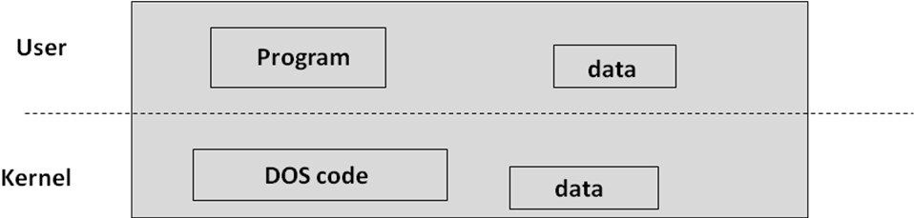
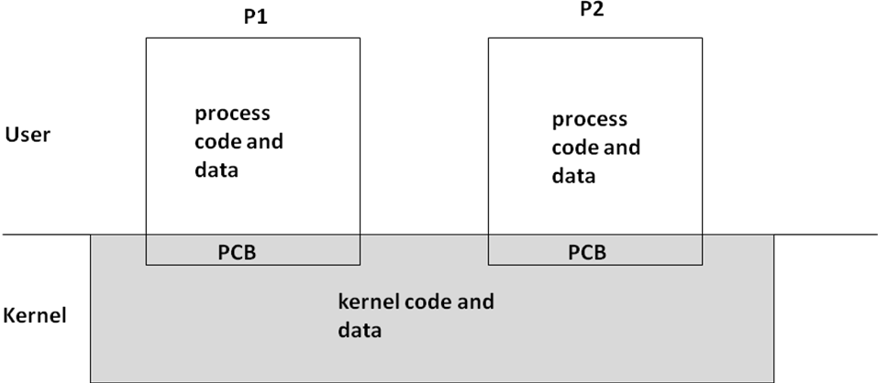
12.7 OS support for threads

Slide 56
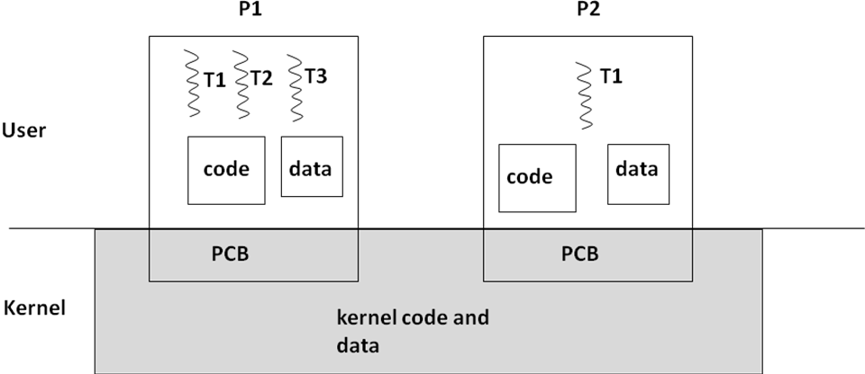
12.7 OS support for threads

Slide 57

12.7 OS support for threads
stack
stack1
stack2
stack3
stack4
heap
heap
global
global
code
code
(a) Single threaded process process
(b) Multi threaded process
(c) Cactus Plant

Slide 58
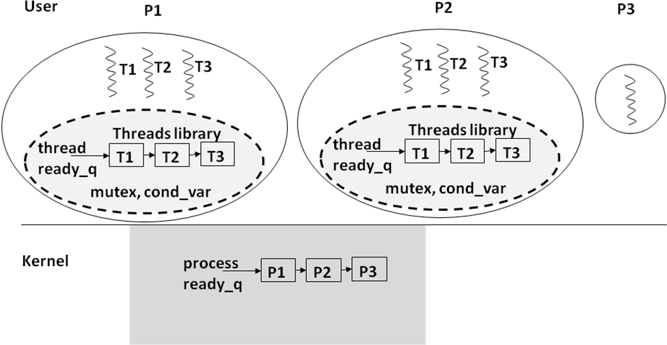
12.7.1 User level threads

Slide 59
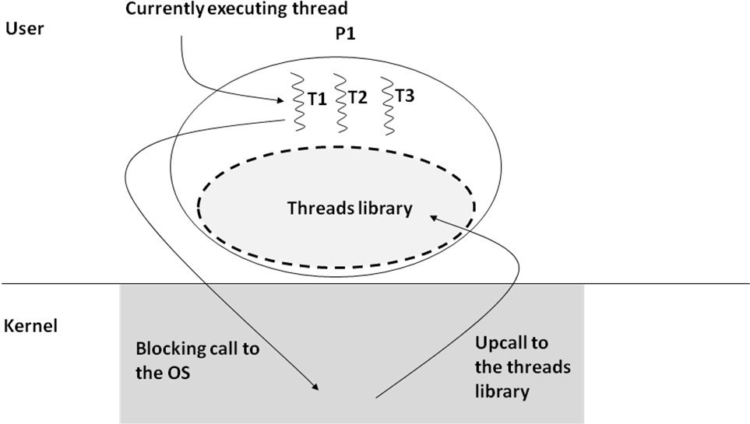
12.7.1 User level threads

Slide 60
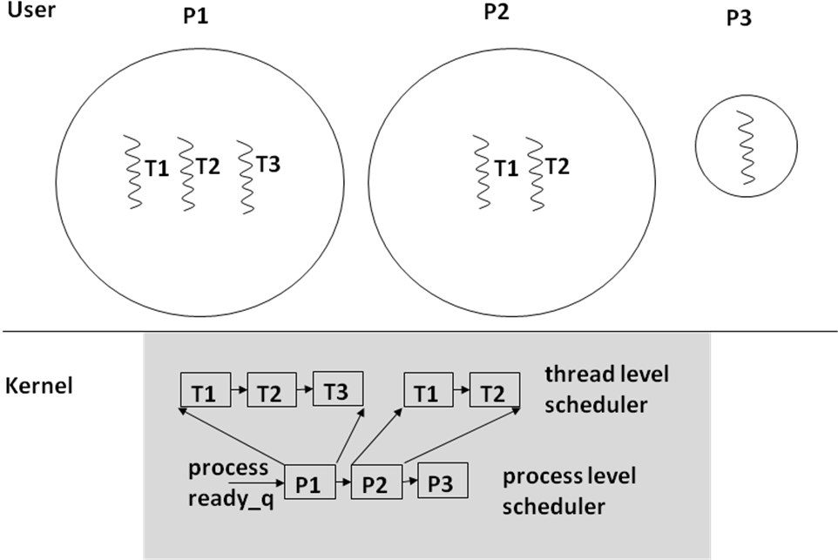
12.7.2 Kernel level threads

Slide 61
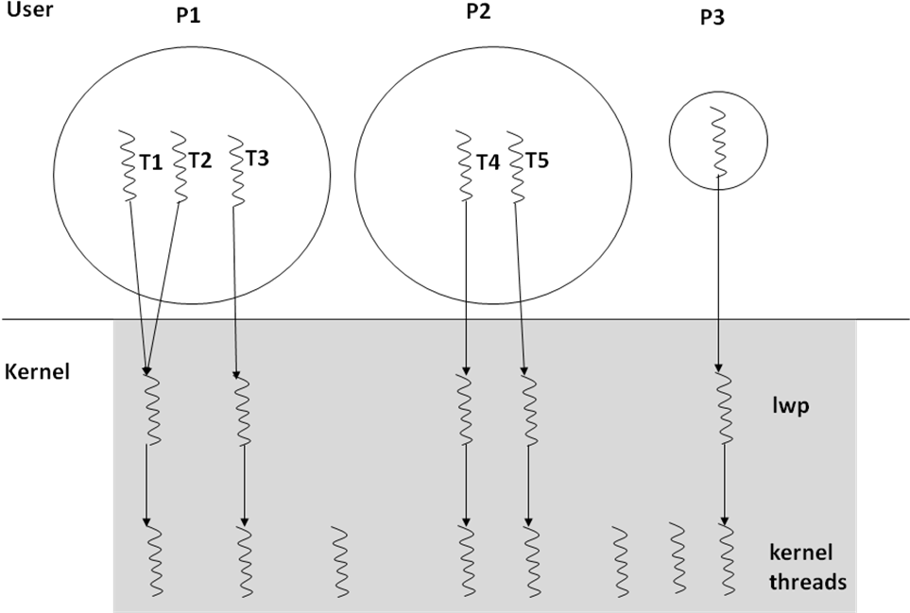
12.7.3 Solaris threads: An example of kernel level threads

Slide 62
12.7.4 Threads and libraries
Original Version
Thread Safe Version
void *malloc(size_t size){
. . .
. . .
return(memory_pointer);
}
mutex_lock_type cs_mutex;
void *malloc(size_t size) {
thread_mutex_lock(cs_mutex);
. . .
. . .
thread_mutex_unlock(cs_mutex);
return (memory_pointer);
}

Slide 63
12.8 Hardware support for multithreading in a uniprocessor
Thread creation and termination
Communication among threads
Synchronization among threads

Slide 64
12.8.1 Thread creation, termination, and communication among threads
Threads of a process share same page table.
Uniprocessor: Each process has a unique page table.
On thread context switch within the same process
No change to the TLB or the caches since all the memory mapping and contents of the caches remain relevant for the new thread.
Thus, creation and termination of threads, or communication among the threads do not require any special hardware support.

Slide 65
12.8.2 Inter-thread synchronization
Lock:
if (mem_lock == 0)
mem_lock = 1;
else
block the thread;
Unlock:
mem_lock = 0;
Lock and unlock algorithms must be atomic
Datapath actions necessary
Read a memory location
Test if the value read is 0
Set the memory location to 1

Slide 66
12.8.3 An atomic test_and_set instruction
Assume we add the following instruction
Test_And_Set Rx memory-location
Perform the following atomically:
Read the current value of memory-location into some processor register (Rx)
Set the memory-location to a 1

Slide 67
12.8.3 An atomic test_and_set instruction
If the mutex is unlocked (=0)
if the mutex is locked (=1)
test_and_set will return 0 which will mean you have the mutex lock
It will also set the mutex variable to 1
test_and_set will return 1 which will mean you don't have the mutex lock
It will also set the mutex variable to 1 (which is what it was anyway)

Slide 68
12.8.4 Lock algorithm with test_and_set instruction
#define SUCCESS 0
#define FAILURE 1
int unlock(int L)
{
L = 0;
return(SUCCESS);
}
int lock(int L) {
int X;
while ( (X = test-and-set (L)) == FAILURE ) {
/* current value of L is 1 implying
* that the lock is currently in use
*/
block_the_thread();
/* Threads library puts thread in
* queue; when lock is released it
* allows this thread to check
* availability of lock again
*/
}
/* Falling out of while loop implies that lock
*attempt was successful
*/
return(SUCCESS);
}

Slide 69
12.9 Multiprocessors
Shared Memory
Shared bus
CPU
CPU
. . . .
CPU
CPU
Input/output
Threads of same process share same page table.
Threads of same process have identical views of memory hierarchy despite being on different physical processors.
Threads are guaranteed atomicity for synchronization operations while executing concurrently.

Slide 70
12.9.1 Page tables
Simply
Processors share physical memory
OS satisfies the first requirement by ensuring that page table in shared memory is same for all threads of a given process.
Really
Scheduling threads, replacing pages, maintaining TLB and cache coherency, etc. are complex subjects beyond the scope of this course

Slide 71
12.9.2 Memory hierarchy
Each CPU has its own TLB and Cache
Shared Memory
Shared bus
cache
cache
cache
. . . .
CPU
CPU
CPU

Slide 72
12.9.2 Memory hierarchy
Shared Memory
Shared bus
X
X
X
P1
P2
P3
T1
T2
T3
(a) Multiprocessor cache coherence problem
Shared Memory
Shared Memory
invalidate ->
Shared bus
update ->
Shared bus
X -> X’
X -> inv
X -> inv
X -> X’
X -> X’
X -> X’
P1
P2
P3
P1
P2
P3
T1
T2
T3
T1
T2
T3
(b) write-invalidate protocol
(c) write-update protocol

Slide 73
12.9.3 Ensuring atomicity
The lock and unlock algorithms presented earlier will function in this environment provided the atomicity requirements are met

Slide 74
12.10.1.1 Deadlocks
There are four conditions that must hold simultaneously for processes to be involved in resource deadlock in a computer system:
Mutual exclusion: Resource can be used only in a mutually exclusive manner
No preemption: Process holding a resource has to give it up voluntarily
Hold and wait: A process is allowed to hold a resource while waiting for other resources
Circular wait: There is a cyclic dependency among the processes waiting for resources (A is waiting for resource held by B; B is waiting for a resource held by C; C….X; X is waiting for a resource held by A)

Slide 75
12.10.1.1 Deadlocks
Strategies to eliminate deadlock problems
Avoidance
Foolproof
Costly
Prevention
More risk
More efficient
Detection
Must detect and recover

Slide 76
12.10.1.1 Deadlocks
Example assume there are three resources:
1 display
1 keyboard
1 printer.
Further assume there are four processes:
P1 needs all three resources
P2 needs keyboard
P3 needs display
P4 needs keyboard and display
 | Keyboard | Display | Printer
P1 | Needs | Needs | Needs
P2 | Needs
P3 |  | Needs
P4 | Needs | Needs

Slide 77
12.10.1.1 Deadlocks
 | Keyboard | Display | Printer
P1 | Needs | Needs | Needs
P2 | Needs
P3 |  | Needs
P4 | Needs | Needs
Avoidance:
Allocate all needed resources as a bundle at the start to a process. This amounts to
Not starting P2, P3, or P4 if P1 is running
Not starting P1 if any of the others are running.
Prevention:
Have an artificial ordering of the resources, say keyboard, display, printer. Make the processes always request the three resources in the above order and release all the resources a process is holding at the same time upon completion.
This ensures no circular wait (P4 cannot be holding display and ask for keyboard
P1 cannot ask for printer without already having the display, etc.
Detection:
Allow resources to be requested individually and in any order.
Assume all processes are restartable.
If a process (P2) requests a resource (say keyboard) which is currently assigned to another process (P4) and if P4 is waiting for another resource, then force a release of keyboard by aborting P4, assign the KBD to P2, and restart P4.

Slide 78
12.10.1.2 Advanced Synchronization Algorithms
Needs of concurrent programs:
Ability for a thread to execute some sections of the program (critical sections) in a mutually exclusive manner (i.e., serially),
Ability for a thread to wait if some condition is not satisfied
Ability for a thread to notify a peer thread who may be waiting for some condition to become true.

Slide 79
12.10.1.2 Advanced Synchronization Algorithms
Theoretical programming constructs have been developed which encapsulate and abstract many of the details that we have had strewn throughout our program
One such construct is the Monitor
Languages such as Java have adoped some of the monitor concepts
synchronized methods
wait and notify methods to allow blocking and resumption of a thread inside a synchronized method

Slide 80
12.10.1.3 Scheduling in a Multiprocessor
Cache Affinity
Lengthening quantum for thread holding lock
Per processor scheduling queues
Space sharing
Delay starting an application until there are sufficient processors to devote one processor per thread. Good service to apps but some waste
Gang scheduling
See next slide

Slide 81
12.10.1.3 Scheduling in a Multiprocessor
Gang scheduling
Similar to space sharing except processors time share among different threads
Time divided into fixed size quanta
All CPUs are scheduled at beginning of each time quantum
Scheduler uses principle of gangs to allocate processors to threads of a given application
Different gangs may use same set of processors in different time quanta
Multiple gangs may be scheduled at same time depending on availability of processors
Once scheduled association of a thread to a processor remains until next time quantum even if thread blocks (i.e., processor will remain idle)

Slide 82
12.10.1.4 Classic Problems in Concurrency
Producer-Consumer Problem
Readers-Writers Problem
Dining Philosophers Problem

Slide 83
12.10.1.4 Classic Problems in Concurrency
Producer-Consumer Problem
Bounded
Buffer
Producer
Consumer

Slide 84
12.10.1.4 Classic Problems in Concurrency
Readers-Writers Problem
Event | Dates | Seats Available
Air Supply | 3/14 | 4
Bananarama | 6/12 | 2
Cats | 4/19 | 8
Dave Matthews | 5/30 | 4
Evanesence | 2/20 | 6
Fats Domimo | 7/14 | 2
Godspell | 1/19 | 8

Slide 85
12.10.1.4 Classic Problems in Concurrency
Dining Philosophers Problem
Rice
Rice
Rice
Rice
Rice
Rice

Slide 86
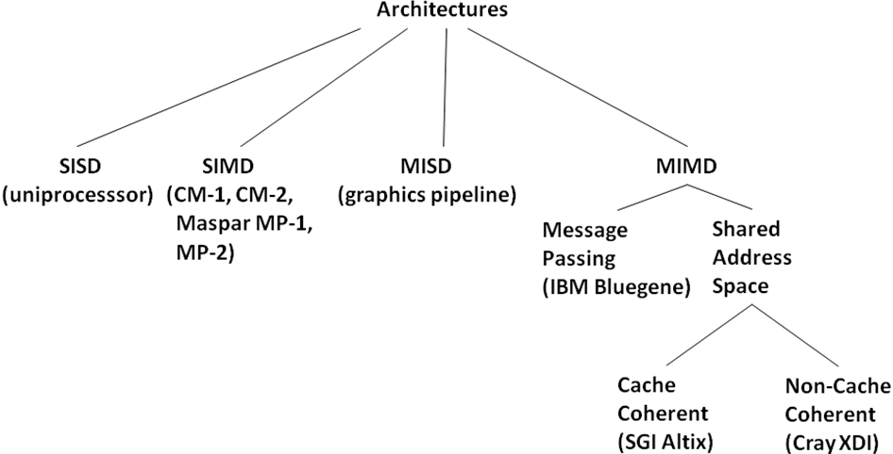
12.10.2.1 Taxonomy of Parallel Architectures

Slide 87
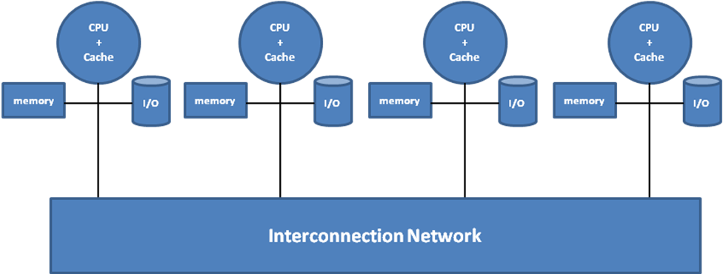
12.10.2.2 Message-Passing vs. Shared Address Space Multiprocessors
Message Passing

Slide 88
12.10.2.2 Message-Passing vs. Shared Address Space Multiprocessors
Shared Address Space
Shared Memory
Shared bus
cache
cache
cache
. . . .
CPU
CPU
CPU

Slide 89
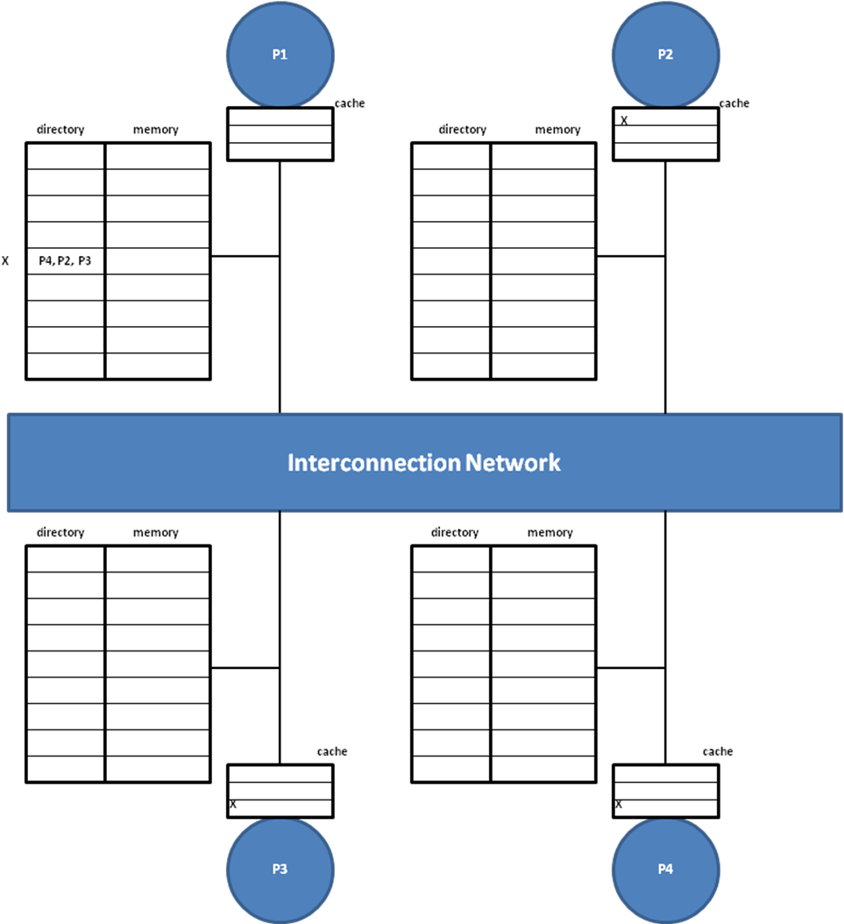
12.10.2.2 Message-Passing vs. Shared Address Space Multiprocessors
Shared Address Space

Slide 90
12.11 Summary
Key concepts in parallel programming with threads,
Operating system support for threads,
Architectural assists for threads
Advanced topics
operating systems
parallel architectures.
Three things application programmer have to worry about in writing threaded parallel programs
thread creation/termination,
data sharing among threads,
synchronization among the threads.

Slide 91
12.11 Summary
User level threads
Kernel Level Threads
Architectural assists needed for supporting threads
Atomic read-modify-write memory operation. (Test-And-Set instruction)
Cache coherence problem.
Advanced topics in operating systems and architecture as they pertain to multiprocessors
Deadlocks,
Sophisticated synchronization constructs such as monitors
Advanced scheduling techniques
Classic problems in concurrency and synchronization
Taxonomy of parallel architectures (SISD, SIMD, MISD, and MIMD)
Interprocessor Communications
Message-passing
Shared memory

Slide 92
12.12 Historical Perspective and the Road Ahead
Parallel computing is an old topic
ILP vs TLP
Loop-level parallelism vs. Functional parallelism
Amdahl's law and ramifications
Parallel as high-end niche market
Advent of killer micros & fast networks leading to clusters

Slide 93
12.12 Historical Perspective and the Road Ahead
Moore's Law vs Thermodynamics
Demand for lower power
Multicore
Many-core

